Slide 1

The dir Function

Slide 2
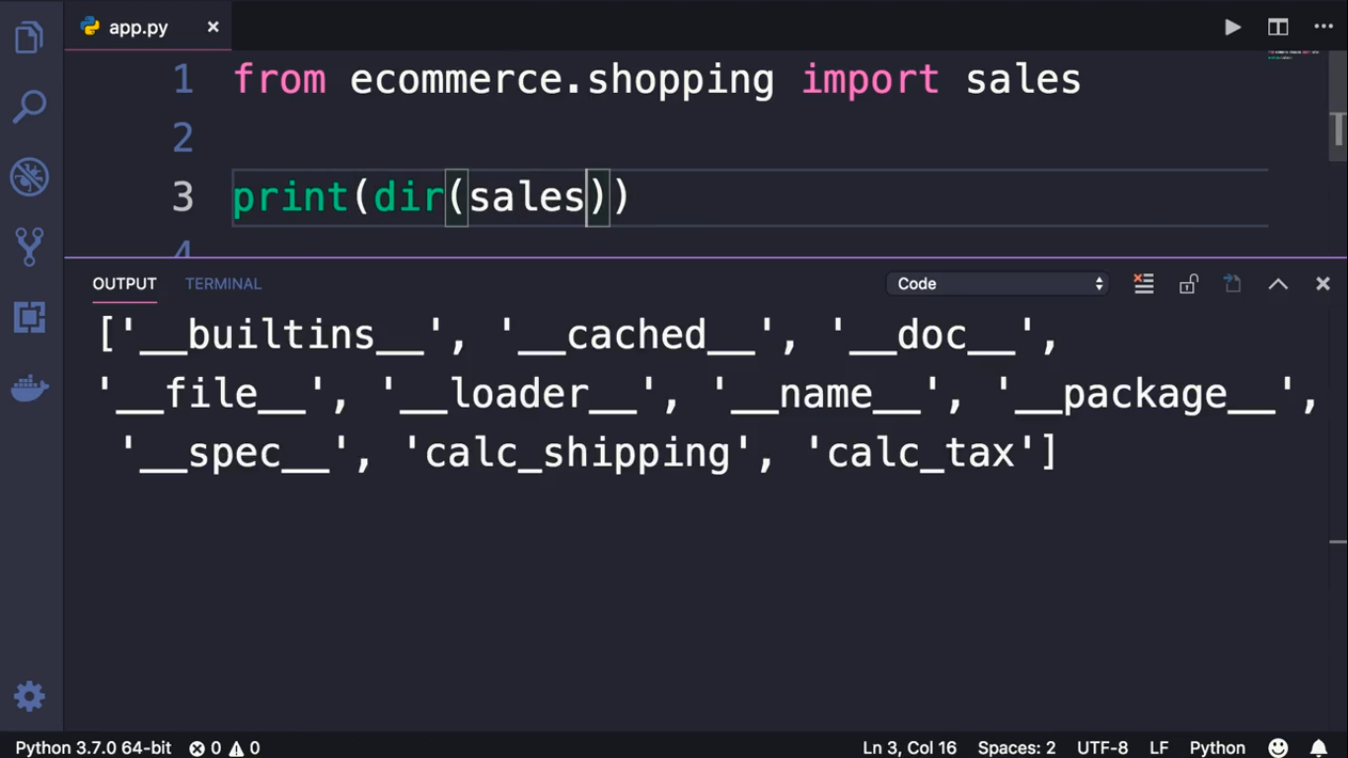

Slide 3
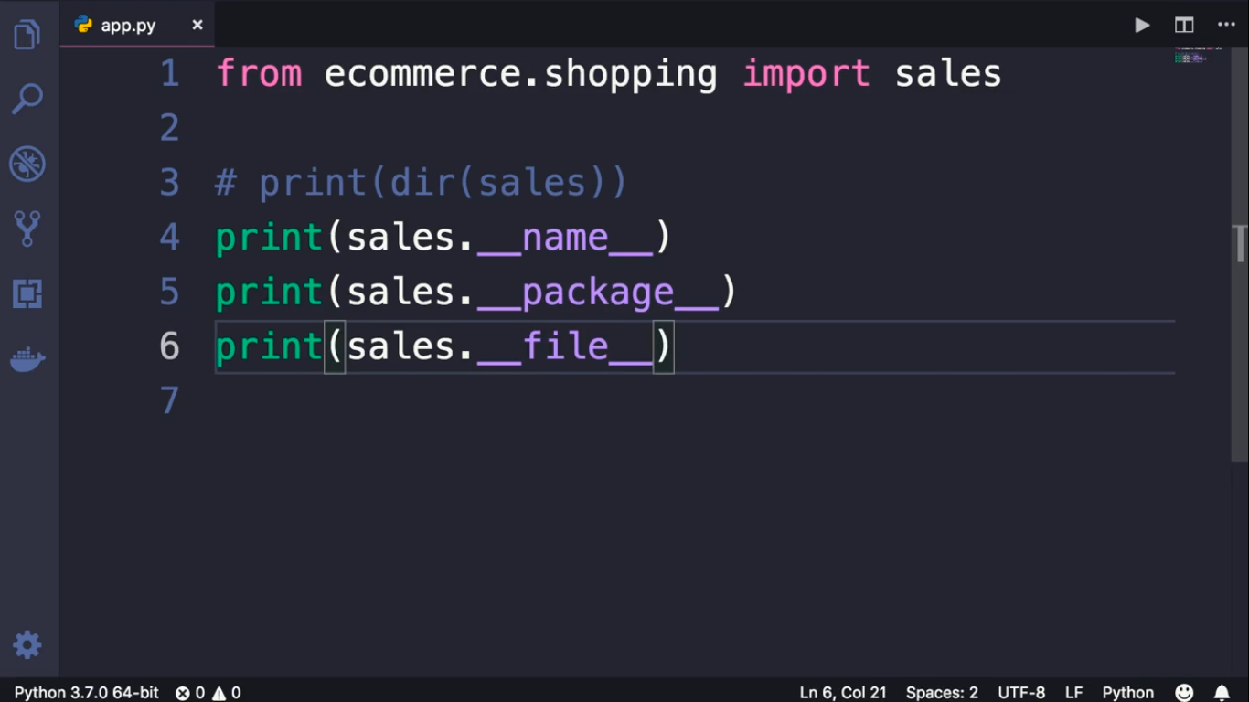

Slide 4
